Slide 1
Visual Understanding meets Knowledge Reasoning
How to harness diverse human professional or commonsense knowledge
Visual Understanding with Knowledge Reasoning
Symbolic
Knowledge Graph
Image Feature Representation Learning
Visual Question Reasoning on General Dependency Tree, CVPR2018
Symbolic Graph Reasoning Meets Convolutions, NIPS2018
Hybrid Knowledge Routed Modules for Large-scale Object Detection, NIPS2018
Deep Reasoning with Knowledge Graph for Social Relationship Understanding, IJCAI2018.
Knowledge-Embedded Representation Learning for Fine-Grained Image Recognition, IJCAI2018
Knowledge-Guided Recurrent Neural Network Learning for Task-oriented Action, ICME2017 Best Paper
Knowledge-Embedded Routing Network for Scene Graph Generation, Work in progress.

Slide 2
Knowledge-Embedded Representation Learning for Fine-Grained Image Recognition
Visual Understanding meets Knowledge Reasoning
Tianshui Chen, Liang Lin*,
Riquan Chen, Yang Wu, Xiaonan Luo

Slide 3

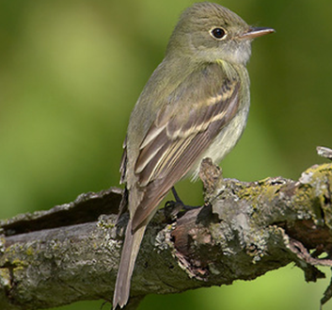
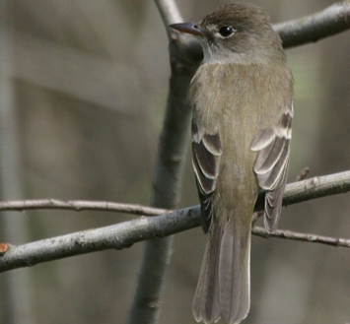
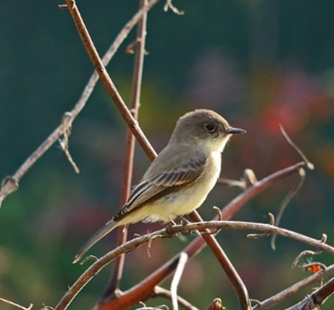
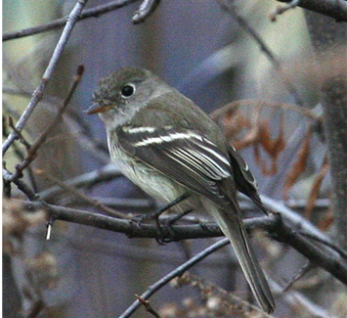
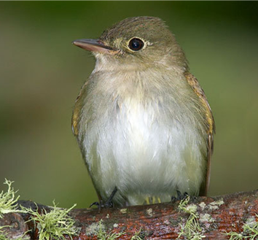
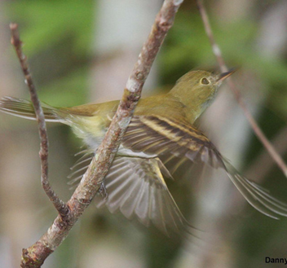
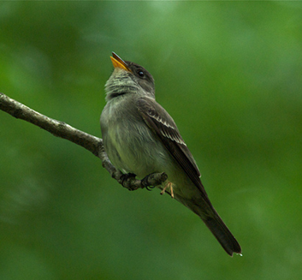
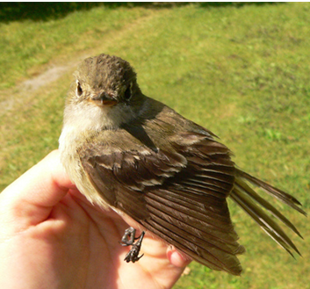
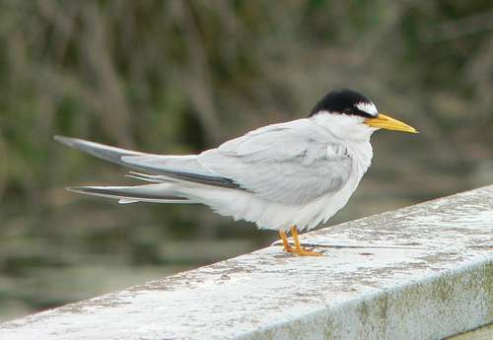
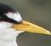
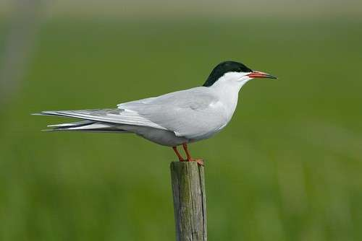
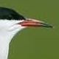
Fine-Grained Image Classification
Objective: Distinguish subordinate categories under a basic category.
Inter- and intra-class variability
Acadian Flycatcher
Least Flycatcher
Details matter a lot
Least Tern
Common Tern
Previous Methods: Locating the attentive regions in terms of discriminative details
Part-based models [1]: Heavily rely on object and part annotations.
Visual attention models [2]: Roughly locate the discriminative regions.
[1] Look Part-Stacked CNN for Fine-Grained Visual Categorization, CVPR2017.
[2] Recurrent Attention Convolutional Neural Network for Fine-Grained Image Recognition, CVPR2017

Slide 4
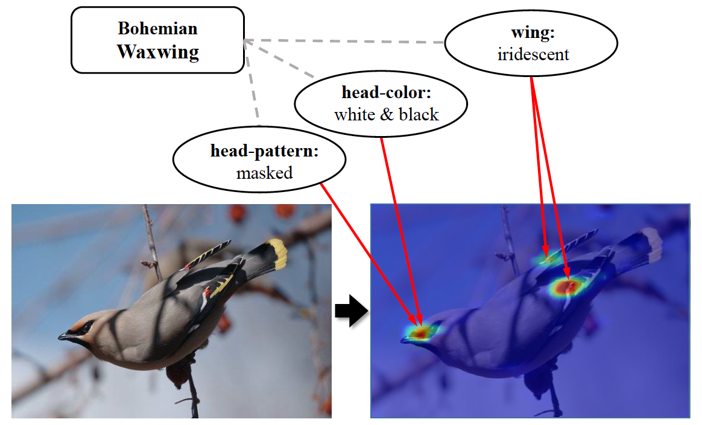
Motivation
Understanding image with the aid of professional knowledge
Correlations between category labels and part-based attributes can be served as extra guidance for fine grained image recognition.
Notes:
太平鸟

Slide 5
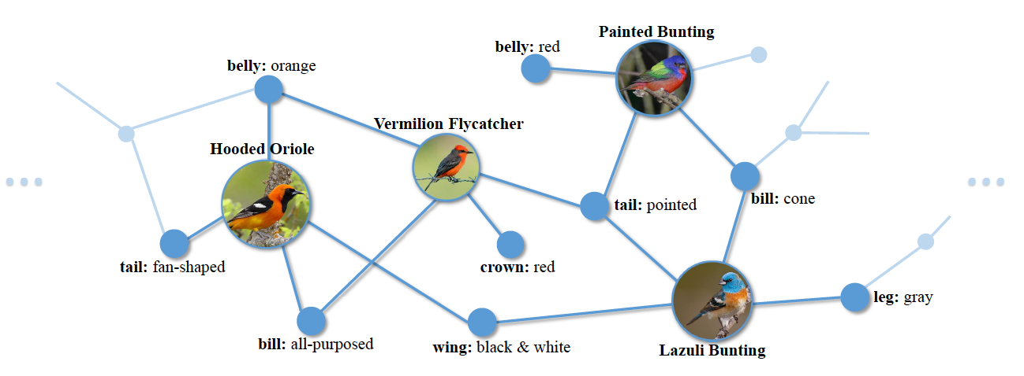
Knowledge graph
The knowledge graph refers to the correlations between categories and attributes
Nodes: the category labels and attributes.
Edges: the correlations between corresponding labels and attributes
Constructed by counting the frequency of the co-occurrence of each category-attribute pair

Slide 6
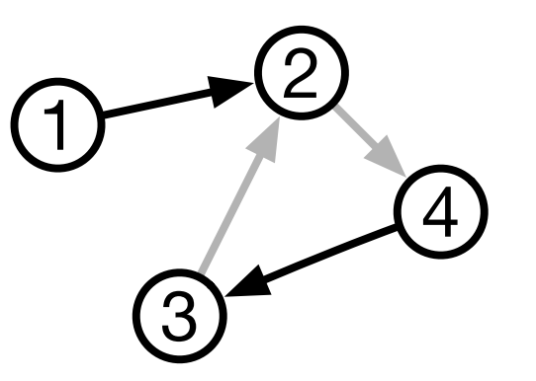
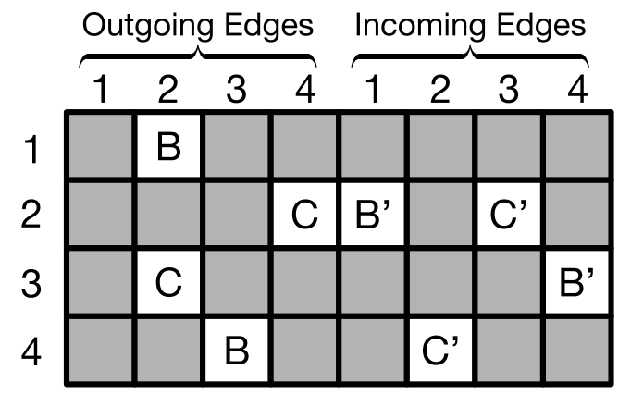
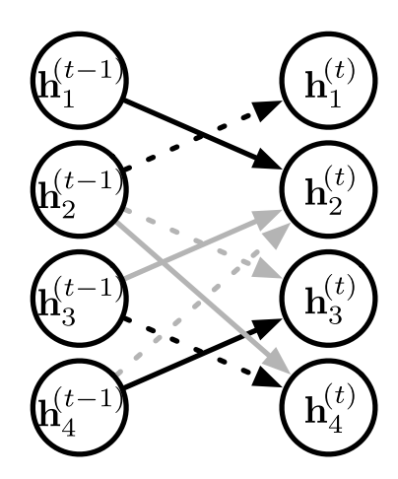
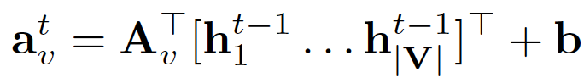
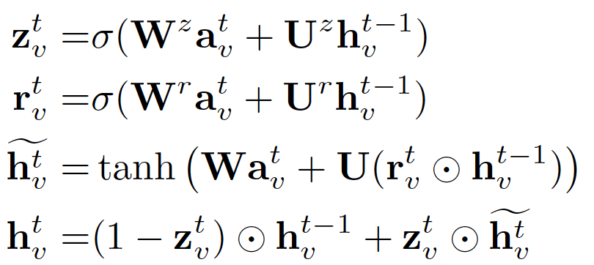
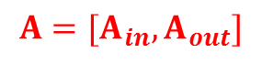

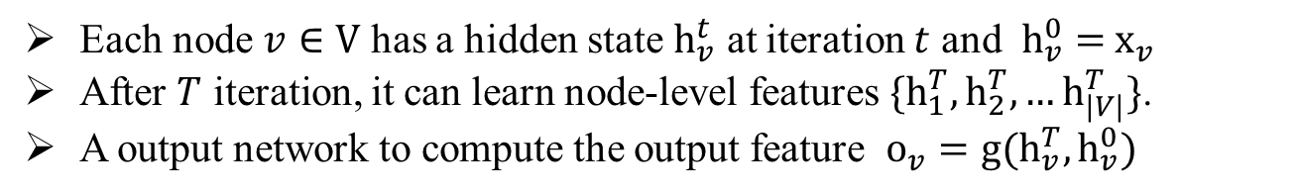
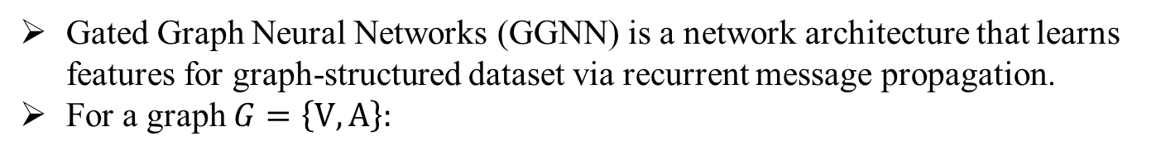
Gated Graph Neural Networks
Gated Graph Neural Networks (GGNN) is a network architecture that learns features for graph-structured dataset via recurrent message propagation.
For a graph $G=\left\{V, A\right\}:$
$$G$$
$$A=[{A_{in},A}_{out}]$$
Message propagation for each nodes $v$:
Hidden state update for each nodes $v$ via a GRU-like process:
Unroll the graph
Each node $v∈V$ has a hidden state $h_{v}^{t}$ at iteration $t$ and $h_{v}^{0}=$ $x_{v}$
After $T$ iteration, it can learn node-level features $\{h_{1}^{T},h_{2}^{T},…h_{|V|}^{T}\}$.
A output network to compute the output feature $o_{v}=g(h_{v}^{T},h_{v}^{0})$

Slide 7
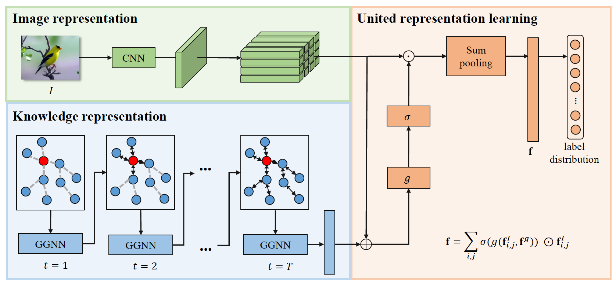

Knowledge Embedded Representation Learning
Image feature extraction
Knowledge representation learning
United representation learning
A compact bilinear model to extract image feature

Slide 8
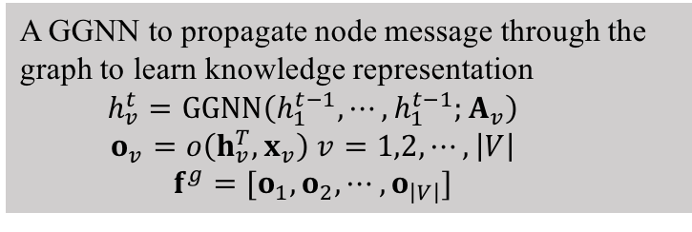
Knowledge Embedded Representation Learning
Image feature extraction
Knowledge representation learning
United representation learning
A GGNN to propagate node message through the graph to learn knowledge representation
$$h_{v}^{t}=GGNN\left(h_{1}^{t−1},⋯,h_{1}^{t−1};A_{v}\right)$$
$$o_{v}=o\left(h_{v}^{T},x_{v}\right) v=1,2,⋯,\left|V\right|$$
$$f^{g}=[o_{1},o_{2},⋯,o_{\left|V\right|}]$$
Notes:
O_v: output feature by integrating the initial features and the features at t-iteration.

Slide 9
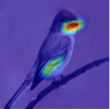
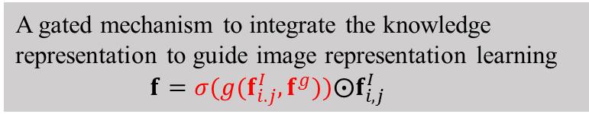
Knowledge Embedded Representation Learning
Image feature extraction
Knowledge representation learning
United representation learning
A gated mechanism to integrate the knowledge representation to guide image representation learning
$$f=σ(g(f_{i.j}^{I},f^{g}))⨀f_{i,j}^{I}$$
Notes:
g (): attention function

Slide 10
Knowledge Embedded Representation Learning
Advantages compared with existing methods:
Enhances the feature representation to facilitate distinguish subtle difference between different subordinate categories.
Learn feature maps with a meaningful configuration that the highlighted region finely accord with the discriminative attributes.

Slide 11
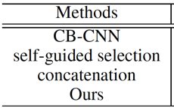
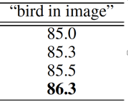
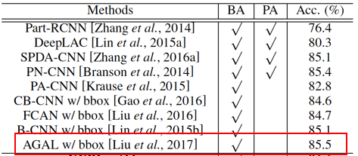

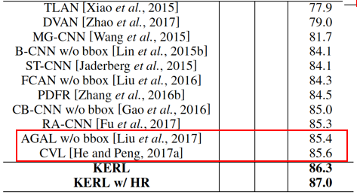
Experiment on Caltech-UCSD bird dataset
200 categories, 5,994 images for training and 5,794 images for test
Baseline
State of the art
Baseline methods:
CB-CNN: compact bilinear model
Self-guided selection: remove the knowledge representation during the gated selection of image features
Concatenation: Simply concatenate the image feature and knowledge representation for recognition.
Improve the accuracies by 1.3% and 1.4% on two general setting of the CUB dataset

Slide 12
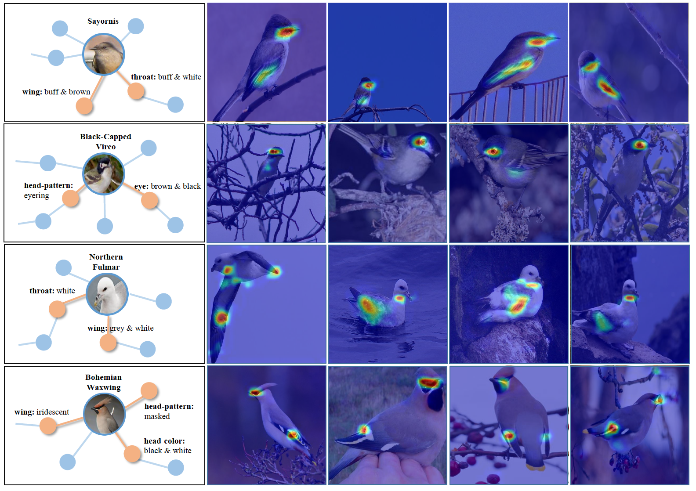
Representation visualization
Explicitly associating specific attributes with image representations

